Slide 1



SRI VENKATESWARA COLLEGE OF ENGINEERING
(Approved by AICTE, New Delhi & Affiliated to JNTUA, Ananthapuram) Balaji Nagar, KADAPA – 516003
ADD COMPANY NAME
A Presentation
on
Major Project
“LEAF DISEASE DETECTION USING IMAGE PROCESSING”
Submitted by
SHAIK IMRAN 21KH1A0478
VALLURU BHARGAVI 21KH1A0490
P.A. BHARATH KUMAR REDDY 22KH5A0415
CHIRLU KRISHNA MOHAN 22KH5A0405
Under the guidance of
Mr. A. M. SHAFEEULLA, _{M.Tech.}
Assistant Professor, Department of ECE
DEPARTMENT OF ELECTRONICS AND COMMUNICATION ENGINEERING

Slide 2


CONTENTS
Project Tittle
Abstract
Introduction
Objectives Existing methods
Proposed method Algorithms used Software requirements Expected outcomes
Advantages
Applications
Conclusion
References

Slide 3
Tittle of the Project
LEAF DISEASE DETECTION USING IMAGE PROCESSING

Slide 4
ABSTRACT
Agriculture plays a vital role in the economy, with plant health directly impacting crop yield and quality. Identifying plant diseases at an early stage is essential to prevent losses and ensure efficient farming. Traditional disease detection methods rely on manual observation, which is time-consuming and requires expert knowledge. This project presents an automated leaf disease detection system using image processing techniques.
The proposed system utilizes K-means clustering for segmenting affected leaf areas and Support Vector Machine (SVM) or Multi-SVM for classification. Features such as color, texture, and shape are extracted to improve accuracy in disease identification. The system processes digital images of leaves, enhances their quality, segments the disease-affected regions, and classifies the disease type. The method is efficient, cost-effective, and provides early detection, reducing the need for excessive pesticide use.

Slide 5
INTRODuction
Indian economy is dependent of agricultural productivity. Over 70% of rural homes depend on agriculture. Agriculture pays about 17% to the total GDP and provides employment to over 60% of the population. Therefore detection of plant diseases plays a vital key role in the arena of agriculture. Indian agriculture is composed of many crops like rice, wheat. Indian farmers also grow sugarcane, oilseeds, potatoes and non-food items like coffee, tea, cotton, rubber. All these crops grow based on strength of leaves and roots. There are things that lead to different disease for the plant leaves, which spoiled crops and finally it will effect on economy of the country. These big losses can be avoided by early identification of plant diseases. Accurate detection of plant disease is needed to strengthen the field of agriculture and economy of our country.

Slide 6
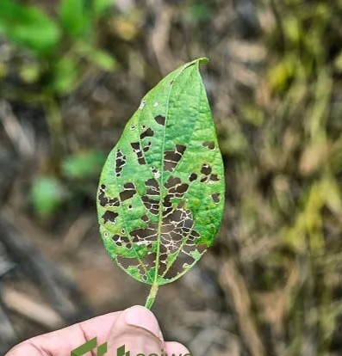
OBJECTIVES
To implement leaf diseases detection with improvement accuracy.
Segmentation of diseases part of leaf.
To get the processed leaf image as an input.
To segment the image using K-Means clustering algorithm.
Finally provide the type of disease attacked in the leaf using SVM classifier and severity level.

Slide 7
EXISTING METHODS
Naked Eye Observation
Traditional method where farmers and experts identify diseases manually.
This approach is slow, less accurate, and not feasible for large-scale farming​.
Machine Learning-Based Approaches
Artificial Neural Networks (ANN): Used for classification by training on leaf image datasets.
Support Vector Machines (SVM): Classifies plant diseases after segmentation​.
Deep Learning Approaches
Convolutional Neural Networks (CNN): Used for automatic feature extraction and classification.
Occlusion-Based Deep Learning: Helps localize disease regions on leaves​.

Slide 8
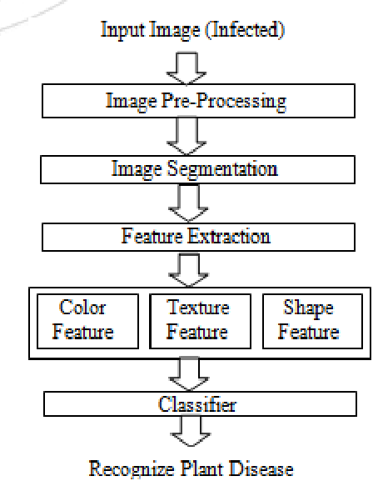
PROPOSED Method
Image Processing Technique
Uses image segmentation, feature extraction, and classification.
K-means clustering is often used to segment the diseased region.
Color co-occurrence method is used for feature extraction​.

Slide 9
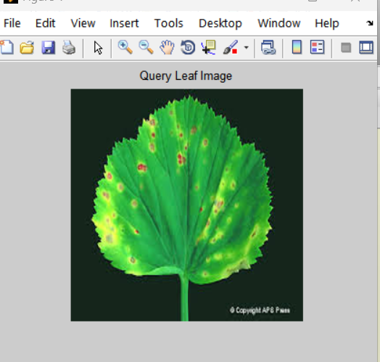
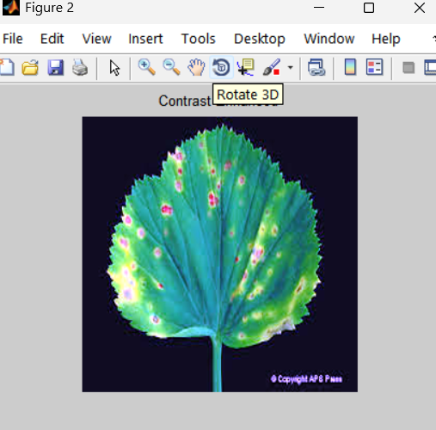
PROPOSED Method
Input Image: An infected leaf image is provided as input to system.
Image Pre-Processing: The image is enhanced by removing noise and adjusting its quality for further analysis

Slide 10
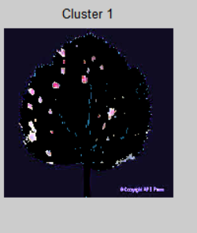
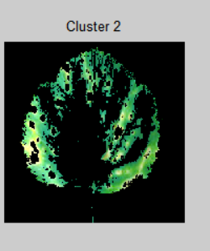
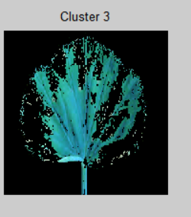
Image Segmentation: The diseased part of the leaf is separated
from the background using techniques like thresholding or clustering.
Feature Extraction: Specific features such as color, texture, and shape are extracted from the segmented region.

Slide 11
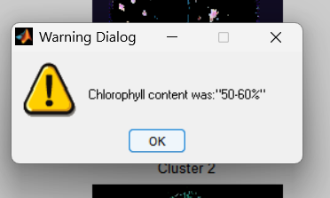

Classifier: A machine learning or deep learning model uses the extracted features to classify the type of disease.
Output: The system recognizes and identifies the plant disease based on the classification

Slide 12
ALGORITHMS USED
K-Means Clustering Algorithm
K-Means is an unsupervised machine learning algorithm used for clustering data points into K groups based on similarity. It is commonly used in image segmentation, including leaf disease detection, to separate healthy and diseased parts of a leaf.
Support Vector Machine (SVM) Algorithm
Support Vector Machine (SVM) is a supervised machine learning algorithm used for classification and regression tasks. It is particularly effective for image classification, including leaf disease detection, by distinguishing between healthy and diseased leaves based on extracted features.

Slide 13

SOFTWARE REQUIREMENTS
Operating System:
Windows, Linux, or macOS Programming Language:
Python / MATLAB Libraries & Frameworks:
OpenCV( Open Source Computer Vision Library) – For image processing and segmentation
NumPy & Pandas – For data handling (If using python)
Scikit-learn – For implementing K-Means, SVM, and feature extraction
Matplotlib & Seaborn – For visualization of results

Slide 14
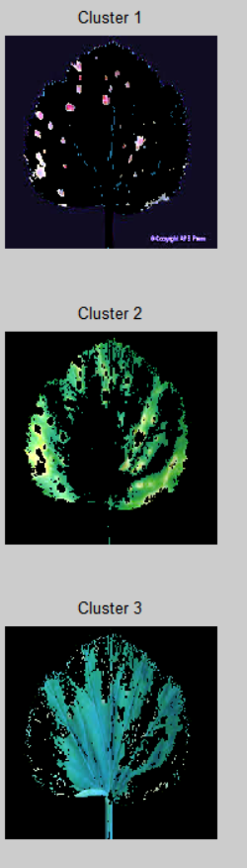
RESULTS

Slide 15
PARAMETERS CALCULATED
Mean → (μ) = (Σx) / n
sum of all values in dataset / total no. of values in dataset.
Standard deviation → SD = √[(Σ(xi - μ)²) / (n - 1)]
varaiation exists in a dataset.
Entropy → H(X) = - ∑ p(x) log2 p(x)
measure of uncertainity and disorder of the affected leaf.
RMS → √[(x₁² + x₂² + ... + xₙ²) / n]
Arithmetic mean of the squares of a group of values.
Variance → σ² = Σ(xi - μ)² / (n - 1)
Differrence between healthy and affected leaf.
Smoothness → 1 - (σ / (σ + 1))
Texture of healthy leaf.

Slide 16
FUTURE SCOPE
The implementation of leaf disease detection using image processing opens up numerous possibilities for future development and application.
Integration with IoT Devices: Incorporating IoT sensors and devices can automate real-time monitoring of plant health in large agricultural fields, providing farmers with instant alerts and actionable data.
Mobile App Development: Creating a mobile application with an intuitive GUI can make disease detection accessible to farmers, enabling them to capture leaf images using their smartphones and receive instant diagnosis.
AI and Deep Learning Enhancement: Implementing advanced machine learning models, particularly deep learning (CNNs), can improve the accuracy of disease classification, especially for complex or multiple infections.

Slide 17
ADVANTAGES
Early Detection: Identifying diseases in their early stages helps prevent the spread of infections and minimizes damage to crops.
Increased Crop Yield: Timely detection and treatment ensure healthier plants, leading to better productivity and yield.
Environmentally Friendly: Accurate detection reduces the excessive use of chemicals, contributing to sustainable farming practices.
Enhanced Food Security: Healthy crops lead to stable food production, contributing to global food security.
APPLICATIONS
Detecting diseases on leaf of plant at early stages gives strength to overcome it and treat it appropriately by providing the details to the farmer that which prevention action should be taken.
Agriculture crop diseases detection for treatment..

Slide 18
CONCLUSION
Leaf disease detection using image processing is a powerful and efficient approach to identifying plant diseases at an early stage. By leveraging image processing techniques, such as K-Means clustering for segmentation, feature extraction methods, and classification using machine learning algorithms like SVM and CNN, this system provides a fast, accurate, and automated solution for disease identification.
This technology helps reduce crop losses, minimize pesticide usage, and improve agricultural productivity. With advancements in AI and deep learning, future developments can enhance accuracy and enable real-time disease detection through mobile applications and cloud-based systems.
Implementing automated leaf disease detection ensures sustainable farming practices, increases food security, and supports farmers with data-driven solutions for plant health monitoring. 🚀🌿

Slide 19
Reference's
Shrivastava, V., & Singh, P. (2021). "Leaf Disease Detection Using Image Processing Techniques: A Comprehensive Review." International Journal of Computer Applications.
Brahimi, M., Boukhalfa, K., & Moussaoui, A. (2018). "Deep learning for plant diseases: Detection and saliency map visualisation." Multimedia Tools and Applications.
Amara, J., Bouaziz, B., & Algergawy, A. (2017). "A Deep Learning-based Approach for Banana Leaf Diseases Classification." arXiv Preprint.
Gonzales, R. C., & Woods, R. E. (2018). Digital Image Processing (4th Edition). Pearson.
Jain, A. K. (2021). Fundamentals of Digital Image Processing. Prentice Hall.

Slide 20
THANK YOU

